Slide 1
Introduction Artificial
Intelligence
Dr. ABHISHEK SHARMA
Computer Science and Engineering
GEU

Slide 2
Some Definitions
Prehistory and History of AI
Where are we headed?

Slide 3
What’s Intelligence?
Intelligence (dictionary)
capacity for learning, reasoning, understanding, and similar forms of mental activity; aptitude in grasping truths, relationships, facts, meanings, etc.
In particular, we could say:
Ability to act as human beings
Solve problems Think rationally
Artificial intelligence …
Building a machine that is (or seems to be at the eyes of the beholder) intelligent

Slide 4
What is artificial intelligence?
It is the science and engineering of making intelligent machines, especially intelligent computer programs. It is related to the similar task of using computers to understand human intelligence, but AI does not have
to confine itself to methods that are biologically observable.
Yes, but what is intelligence?
Intelligence is the computational part of the ability to achieve goals in the world. Varying kinds and degrees of intelligence occur in people, many animals and some machines.

Slide 5
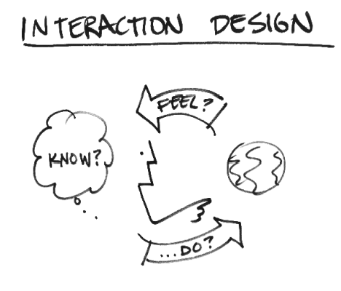

What’s Involved in Intelligence?
Ability to interact with the real world
to perceive, understand, and act
e.g., speech recognition and understanding
Searching the best solution
Reasoning and Planning
modeling the external world, given input
solving new problems, planning, and making decisions
ability to deal with unexpected problems, uncertainties
Learning and Adaptation
we are continuously learning and adapting
our internal models are always being “updated”
e.g., a baby learning to categorize and recognize animals

Slide 6
AI Is Not Alone at Home
□ Crossbreeding of a lot of fields
Philosophy
Logic, methods of reasoning, mind as physical system, foundations of learning, language, rationality.
Mathematics
Formal representation and proof, algorithms, computation, (un)decidability, (in)tractability
Statistics
Modeling uncertainty, learning from data
Economics
Utility, decision theory, rational economic agents
Neuroscience
Neurons as information processing units
Psychology / Neuro Science
How do people behave, perceive, process cognitive information, represent knowledge
Computer Engineering
Building fast computers
Control Theory
Design systems that maximize an objective function over time
Linguistics
Knowledge representation, grammars

Slide 7
Prehistory of AI
More specific, tangible advances
13th century.
Talking heads were said to have been created (Roger Bacon
and Albert the Great).
Ramon Lull, Spanish theologian, invented machines for discovering nonmathematical truths through combinatory.

Slide 8
Prehistory of AI
More specific, tangible advances (cont.)
15th century
Invention of printing using moveable type. Gutenberg Bible printed (1456).
15th-16th century
Clocks, the first modern measuring machines, were first produced using lathes.
16th century
Clockmakers extended their craft to creating mechanical animals and other novelties.

Slide 9
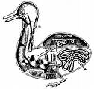
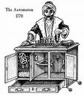
Prehistory of AI
More specific, tangible advances (cont.)
18th century – Mechanical toys
Vaucanson’s Duck
Von Kempelen’s phony mechanical chess player

Slide 10
Brief History of AI
The Golden years (1956 – 1974)
‘1960s
Strong funding of AI centers
Building intelligent automata
Searching in complex search spaces
First AI programs that work
Samuel’s checker program (which learns)
Newell and Simon’s Logic Theorist
Gelernter’s geometry engine
Robinson’s complete algorithm for logical reasoning
First programming languages for AI
McCarthy - Lisp (1958)

Slide 11
Brief History of AI
But in parallel… expert systems rise and grow
MYCIN(1972):
Diagnosed infection blood diseases.
It had a set of about 600 rules and started to ask questions.
In some cases, better than human experts.
XCON (1980):
Production-rule-based system that assisted the ordering of a type of computers systems by automatically selecting the computer systems components based on the customers requirements.
Saving $40 million dollars to the company.
2500 rules and processed 80000 orders with 95%-98% accuracy.
The gain in money was because it reduced the need to give free components when the technicians made errors, by speeding the assembly process and by increasing customer satisfaction

Slide 12
Brief History of AI
But in parallel… expert systems rise and grow
PROSPECTOR (1981)
A computer-based consultation system for mineral exploration.
Recommending exploratory drilling
And many others. Search the web for more!
New funding due to this success
AI groups were formed in many large companies to develop expert systems.
1986 sales of AI-based hardware and software were $425 million.

Slide 13
Brief History of AI
Quick pace in the ‘90s
NCSA releases the first web browser, Mosaic
Deep Blue beats Gary Kasparov
Robotic soccer players in RoboCup
Sony corporation introduced the robotic dog AIBO
Remote agent autonomously drive deep space 1
Even moving faster in the 00’s
iRobot introduces the vacuum cleaning robot Roomba
DARPA grand challenge (we’ll see it in a minute)
A Touareg R5 won the challenge
Machine Learning

Slide 14
Some Cool Applications
Three cool applications among hundreds
Deep Blue
DARPA Grand Challenge
Robotics Cog
Loebner Prize
Roomba
Rob-Cup
ASIMO
Data mining
Stock Market
Medical Diagnosis
Machine Learning

Slide 15
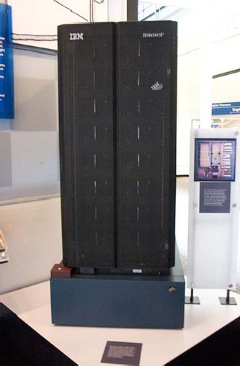
Deep Blue
Origins at CMU
It was a massively parallel, system with 30-nodes
Machine Learning

Slide 16
DARPA Grand Challenge
Grand Challenge
Cash prizes ($1 to $2 million) offered to first robots to complete a long course completely unassisted
Stimulates research in vision, robotics, planning, machine learning, reasoning, etc
2004 Grand Challenge:
150 mile route in Nevada desert
Furthest any robot went was about 7 miles
… but hardest terrain was at the beginning of the course
2005 Grand Challenge:
132 mile race
Narrow tunnels, winding mountain passes, etc
Stanford 1st, CMU 2nd, both finished in about 6 hours
Machine Learning

Slide 17
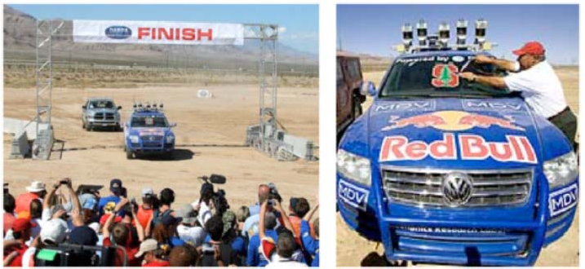
DARPA Grand Challenge
□ http://cs.stanford.edu/group/roadrunner/
Machine Learning

Slide 18
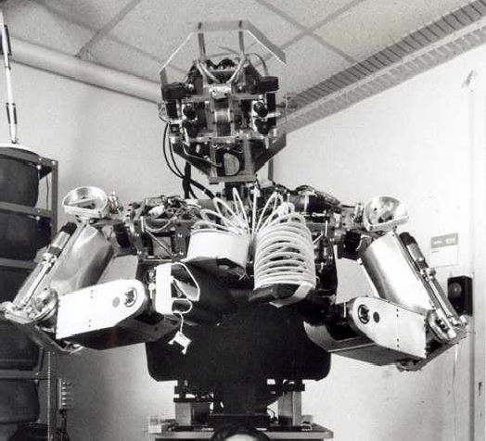
Robotics - Cog
□ Humanoid intelligence requires humanoid interactions with the world
Machine Learning

Slide 19
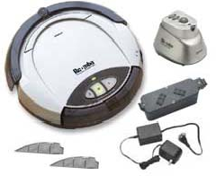
Roomba
□ Go around “smartly” to clean up a house
Machine Learning

Slide 20
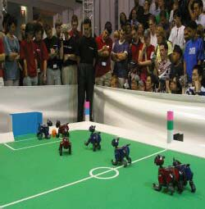
RobCup
□ First official Rob-Cup soccer match (1997)
Machine Learning

Slide 21

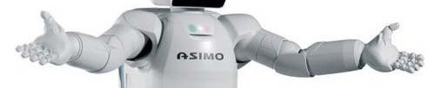

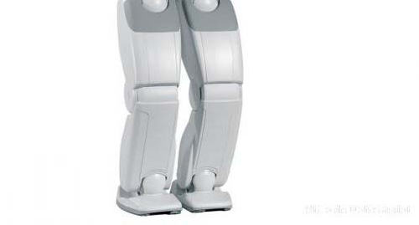
ASIMO
Advanced Step in Innovative Mobility
Able of
Moving
Interacting with human beings
Help people
Machine Learning

Slide 22
Data Mining Explosion
Data mining: Extract novel, useful, and interesting information from data
Why so a big deal?
Companies are generating lots of data about the business
They want to process these data and obtain useful information
Why now, not before?
Computers have a lot of power nowadays
Machine Learning

Slide 23
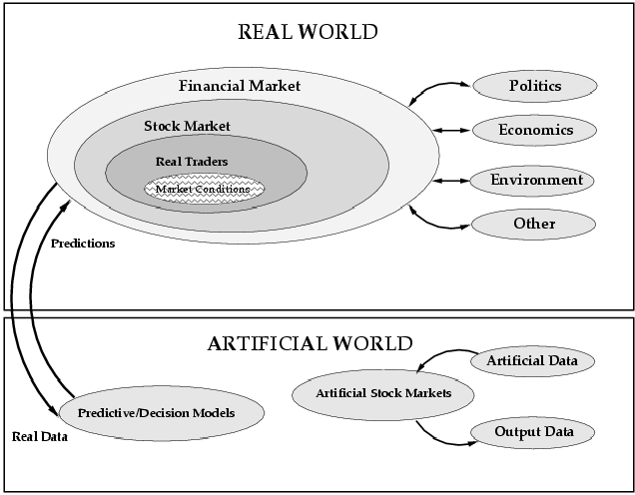
Modeling the Stock Market
Modeling market traders
LETS project: Evolving artificial traders for successful market trading (Sonia Schulenburg et al, 2007)
Evolutionary economics:
Create trend followers and value investors
Let them interact
Evolve a population of strategies
➢
➢
Machine Learning

Slide 24
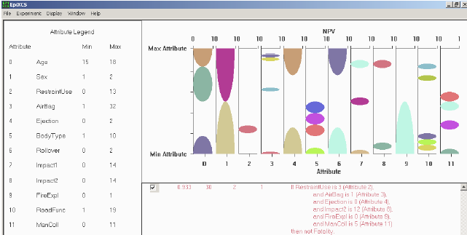
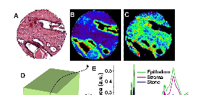

Medical Diagnosis
Data mining
An important application domain of artificial intelligence
John H. Holmes
Epidemiologic study by means of LCSs
Hidden relationships among variables discovered by LCSs
➢
Xavier Llorà et al.
Better than Human Capability in Diagnosing Prostate Cancer Using Infrared Spectroscopic imaging
➢
Machine Learning

Slide 25
But… Slow it down!
All these applications rely on:
Search & Optimization
Knowledge representation
Learning
Planning
These are the four topics that we’ll see in this course. And we will start for the beginning
Machine Learning

Slide 26
Detailed Outline AI1
Solving search problems
Introduction to search problems
Blind search
Informed/heuristic search
Adversary search Constraint satisfaction problems
Knowledge representation
Introduction to knowledge representation
Knowledge representation based on logics
Knowledge and uncertainty
Fuzzy Logics
Lisp
Machine Learning

Slide 27
Detailed Outline AI2
5.
Machine learning
1.
Introduction to machine learning
2.
Supervised learning
1.
Decision trees, Instance-based learning, Bayesian decision theory, Support vector machines and Neural networks
3.
Unsupervised learning – association rules
4.
Unsupervised learning – clustering
5.
Reinforcement learning
6.
New challenges in data mining
Machine Learning

Slide 28
Intelligent Agents
An intelligent agent is a program that can make decisions or perform a service based on its environment, user input and experiences.
These programs can be used to autonomously gather information on a regular, programmed schedule or when prompted by the user in real time.
An intelligent agent could be anything that makes decisions, as a person, firm, machine, or software. It carries out an action with the best outcome after considering past and current.
An AI system is composed of an agent and its environment.
An agent is anything that can be viewed as :
perceiving its environment through sensors.
acting upon that environment through actuators.
Machine Learning

Slide 29
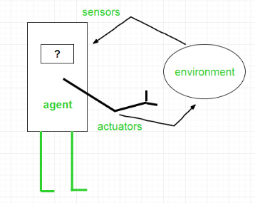
Intelligent Agents
Agent = Architecture + Agent Program
Architecture is the machinery that the agent executes on.
Agent program is an implementation of an agent function.
Examples of Agent:
A software agent has Keystrokes, file contents, received network packages which act as sensors and displays on the screen, files, sent network packets acting as actuators.
A Robotic agent has Cameras and infrared range finders which act as sensors and various motors acting as actuators.
Machine Learning

Slide 30
Types of Agents
Agents can be grouped into five classes based on their degree of perceived intelligence and capability :
Simple Reflex Agents
Model-Based Reflex Agents
Goal-Based Agents
Utility-Based Agents
Learning Agent
Machine Learning

Slide 31
Simple reflex agents
Simple reflex agents ignore the rest of the percept history and act only on the basis of the current percept.
Percept history is the history of all that an agent has perceived to date.
The agent function is based on the condition-action rule. A condition-action rule is a rule that maps a state i.e., condition to an action. If the condition is true, then the action is taken, else not.
This agent function only succeeds when the environment is fully observable.
Example: robotic vacuum cleaner
Machine Learning

Slide 32
Problems with Simple reflex agents are :
Very limited intelligence.
No knowledge of non-perceptual parts of the state.
Usually too big to generate and store.
If there occurs any change in the environment, then the collection of rules need to be updated.
Machine Learning

Slide 33
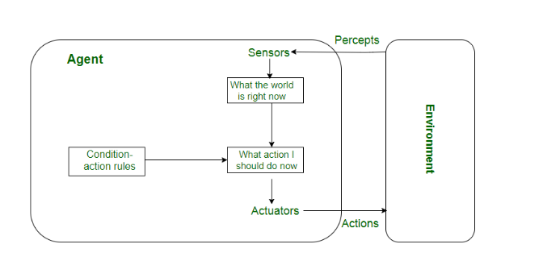
Fig. Block diagram of Simple reflex agents.
Machine Learning

Slide 34
Model-based reflex agents
A model-based reflex agent is an intelligent agent that uses percept history and internal memory to make decisions about the ''model'' of the world around it.
A model-based agent can handle partially observable environments by the use of a model about the world.
Updating the state requires information about :
(i) how the world evolves independently from the agent
(ii) how the agent’s actions affect the world.
Example: self-steering mobile vision,
Machine Learning

Slide 35
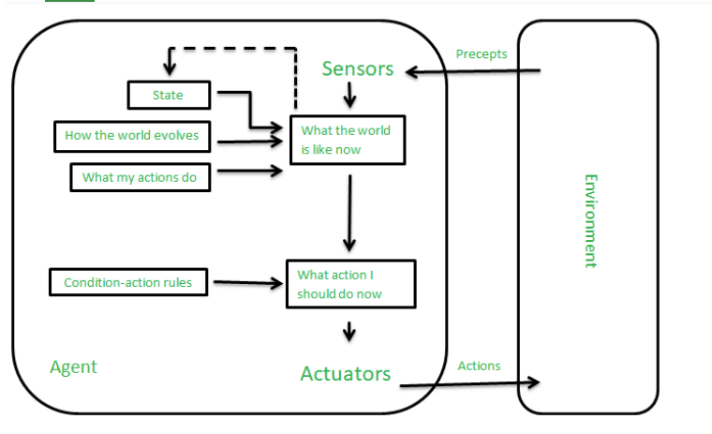
Fig. Block diagram of Model-based reflex agents.
Machine Learning

Slide 36
Goal-based agents
These kinds of agents take decisions based on how far they are currently from their goal(description of desirable situations).
Their every action is intended to reduce its distance from the goal.
They usually require search and planning.
Advantages
The knowledge that supports its decisions is represented explicitly and can be modified, which makes these agents more flexible.
The goal-based agent’s behavior can easily be changed.
Example: any searching robot that has an initial location and wants to reach a destination.
Machine Learning

Slide 37
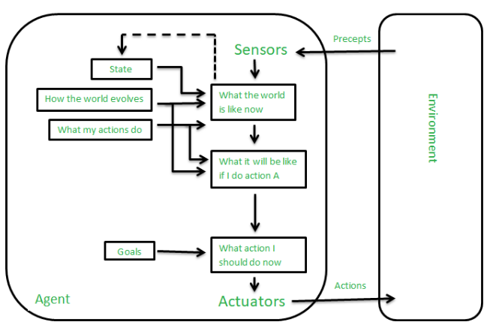
Fig. Block diagram of Goal-based agents.
Machine Learning

Slide 38
Utility-based agents
These agents are similar to the goal-based agent but provide an extra component of utility measurement which makes them different by providing a measure of success at a given state.
Utility-based agent act based not only goals but also the best way to achieve the goal.
Advantages
The Utility-based agent is useful when there are multiple possible alternatives, and an agent has to choose in order to perform the best action.
Example: google driver less car Waymo.
Machine Learning

Slide 39
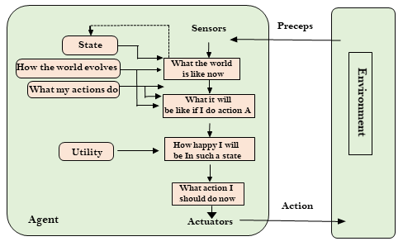
Fig. Block diagram of Utility-based agents.
Machine Learning

Slide 40
Learning Agents
A learning agent in AI is the type of agent which can learn from its past experiences, or it has learning capabilities.
It starts to act with basic knowledge and then able to act and adapt automatically through learning.
A learning agent has mainly four conceptual components:
1. Learning element: It is responsible for making improvements by learning from environment.
2. Critic: Learning element takes feedback from critic which describes that how well the agent is doing with respect to a fixed performance standard.
3. Performance element: It is responsible for selecting external action.
4. Problem generator: This component is responsible for suggesting actions that will lead to new and informative experiences.
Machine Learning

Slide 41
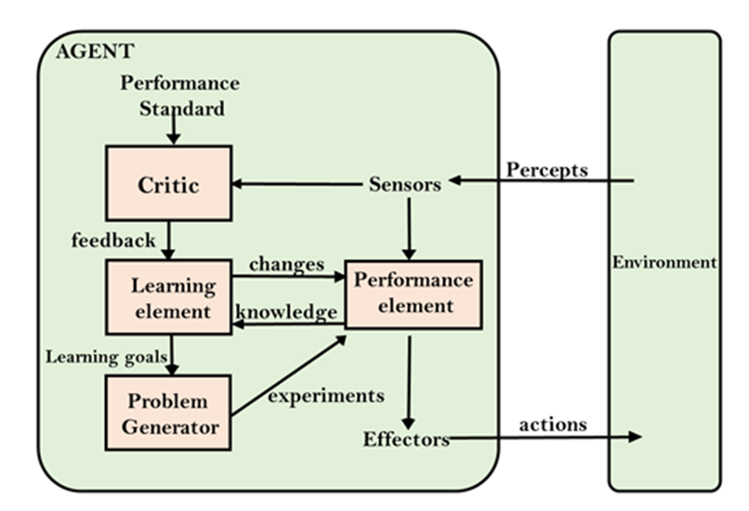
Advantages
Learning agents are able to learn, analyze performance, and look for new ways to improve the performance.
Example: UBER
Machine Learning

Slide 42
Agent Environment in AI
An environment is everything in the world which surrounds the agent, but it is not a part of an agent itself. An environment can be described as a situation in which an agent is present.
The environment is where agent lives, operate and provide the agent with something to sense and act upon it.
Fully observable vs Partially Observable
Static vs Dynamic
Discrete vs Continuous
Features of Environment
Deterministic vs Stochastic
Single-agent vs Multi-agent
Known vs Unknown
Machine Learning

Slide 43
Fully observable vs Partially Observable:
If an agent sensor can sense or access the complete state of an environment at each point of time then it is a fully observable environment, else it is partially observable.
A fully observable environment is easy as there is no need to maintain the internal state to keep track history of the world.
An agent with no sensors in all environments then such an environment is called as unobservable.
Static vs Dynamic:
If the environment can change itself while an agent is deliberating then such environment is called a dynamic environment else it is called a static environment.
Machine Learning

Slide 44
Static environments are easy to deal because an agent does not need to continue looking at the world while deciding for an action.
However for dynamic environment, agents need to keep looking at the world at each action.
Taxi driving is an example of a dynamic environment whereas Crossword puzzles are an example of a static environment.
Discrete vs Continuous:
If in an environment there are a finite number of percepts and actions that can be performed within it, then such an environment is called a discrete environment else it is called continuous environment.
A chess game comes under discrete environment as there is a finite number of moves that can be performed.
A self-driving car is an example of a continuous environment.
Machine Learning

Slide 45
Deterministic vs Stochastic :
When a uniqueness in the agent’s current state completely determines the next state of the agent, the environment is said to be deterministic.
The stochastic environment is random in nature which is not unique and cannot be completely determined by the agent.
Single-agent vs Multi-agent :
An environment consisting of only one agent is said to be a single-agent environment.
A person left alone in a maze is an example of the single-agent system.
An environment involving more than one agent is a multi-agent environment.
The game of football is multi-agent as it involves 11 players in each team.
Machine Learning

Slide 46
Known vs Unknown:
In a known environment, the output for all probable actions is given. Obviously, in case of unknown environment, for an agent to make a decision, it has to gain knowledge about how the environment works.
Turing Test
In 1950, Alan Turing introduced a test to check whether a machine can think like a human or not, this test is known as the Turing Test.
In this test, Turing proposed that the computer can be said to be an intelligent if it can mimic human response under specific conditions.
Machine Learning

Slide 47
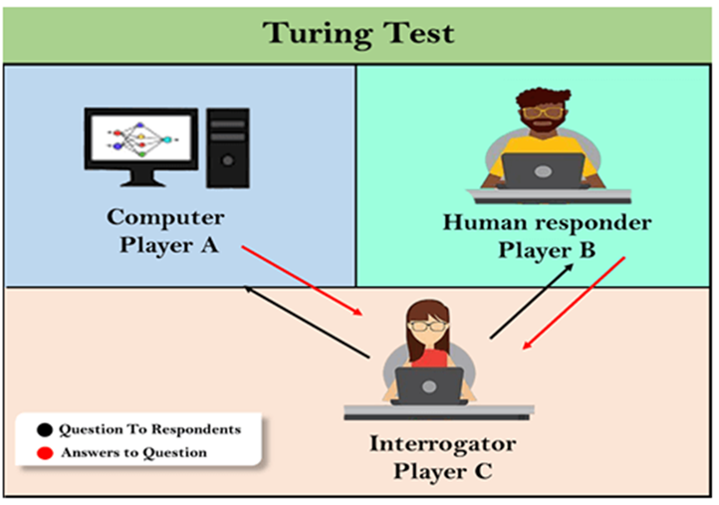
This game involves three players:
Player A is a computer
Player B is human
Player C is an interrogator
Interrogator is aware that one of them is machine, but he needs to identify this on the basis of questions and their responses.
The test result does not depend on each correct answer, but only how closely its responses like a human answer. The computer is permitted to do everything possible to force a wrong identification by the interrogator.
Machine Learning

Slide 48
In this game, if an interrogator would not be able to identify which is a machine and which is human, then the computer passes the test successfully, and the machine is said to be intelligent and can think like a human.
Features required for a machine to pass the Turing test:
Natural language processing: NLP is required to communicate with Interrogator in general human language like English.
Knowledge representation: To store and retrieve information during the test.
Automated reasoning: To use the previously stored information for answering the questions.
Machine learning: To adapt new changes and can detect generalized patterns.
Vision: To recognize the interrogator actions and other objects during a test.
Machine Learning

Slide 49
Motor Control: To act upon objects if requested.
Search Algorithm Terminologies:
Search: Searching is a step by step procedure to solve a search-problem in a given search space. A search problem can have three main factors:
(a) Search Space: Search space represents a set of possible solutions, which a system may have.
(b) Start State: It is a state from where agent begins the search.
(c) Goal test: It is a function which observe the current state and returns whether the goal state is achieved or not.
Search tree: A tree representation of search problem is called Search tree. The root of the search tree is the root node which is corresponding to the initial state.
Machine Learning

Slide 50
Actions: It gives the description of all the available actions to the agent.
Transition model: A description of what each action do, can be represented as a transition model.
Path Cost: It is a function which assigns a numeric cost to each path.
Solution: It is an action sequence which leads from the start node to the goal node.
Optimal Solution: If a solution has the lowest cost among all solutions.
Properties of Search Algorithms:
Completeness: A search algorithm is said to be complete if it guarantees to return a solution if at least any solution exists for any random input.
Machine Learning

Slide 51
Optimality: If a solution found for an algorithm is guaranteed to be the best solution (lowest path cost) among all other solutions, then such a solution for is said to be an optimal solution.
Time Complexity: Time complexity is a measure of time for an algorithm to complete its task.
Space Complexity: It is the maximum storage space required at any point during the search, as the complexity of the problem.
Types of Search algorithm
Uninformed (Blind search) search
Informed search (Heuristic search) algorithms.
Machine Learning

Slide 52
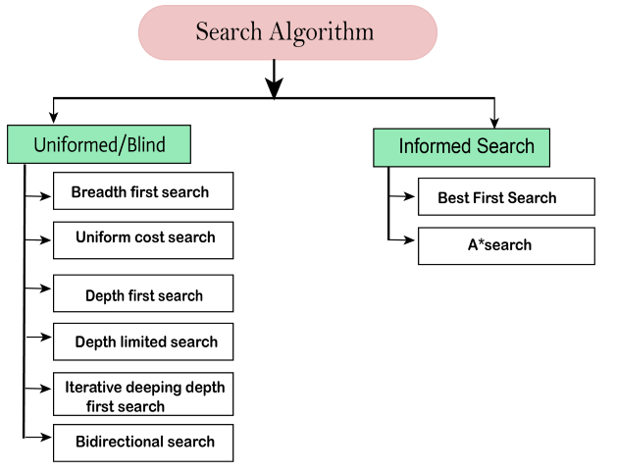
Machine Learning

Slide 53
Uninformed search does not contain any domain knowledge such as closeness, the location of the goal.
Informed search algorithms use domain knowledge. In an informed search, problem information is available which can guide the search. Informed search is also called a Heuristic search.
A heuristic is a way which might not always be guaranteed for best solutions but guaranteed to find a good solution in reasonable time.
Informed search can solve much complex problem which could not be solved in another way.
Machine Learning

Slide 54
Breadth-first Search:
Breadth-first search is the most common search strategy for traversing a tree or graph. This algorithm searches breadthwise in a tree or graph, so it is called breadth-first search.
BFS algorithm starts searching from the root node of the tree and expands all successor node at the current level before moving to nodes of next level.
The breadth-first search algorithm is an example of a general-graph search algorithm.
Advantages:
BFS will provide a solution if any solution exists.
Machine Learning

Slide 55
If there are more than one solutions for a given problem, then BFS will provide the minimal solution which requires the least number of steps.
Disadvantages:
It requires lots of memory since each level of the tree must be saved into memory to expand the next level.
BFS needs lots of time if the solution is far away from the root node.
Machine Learning

Slide 56
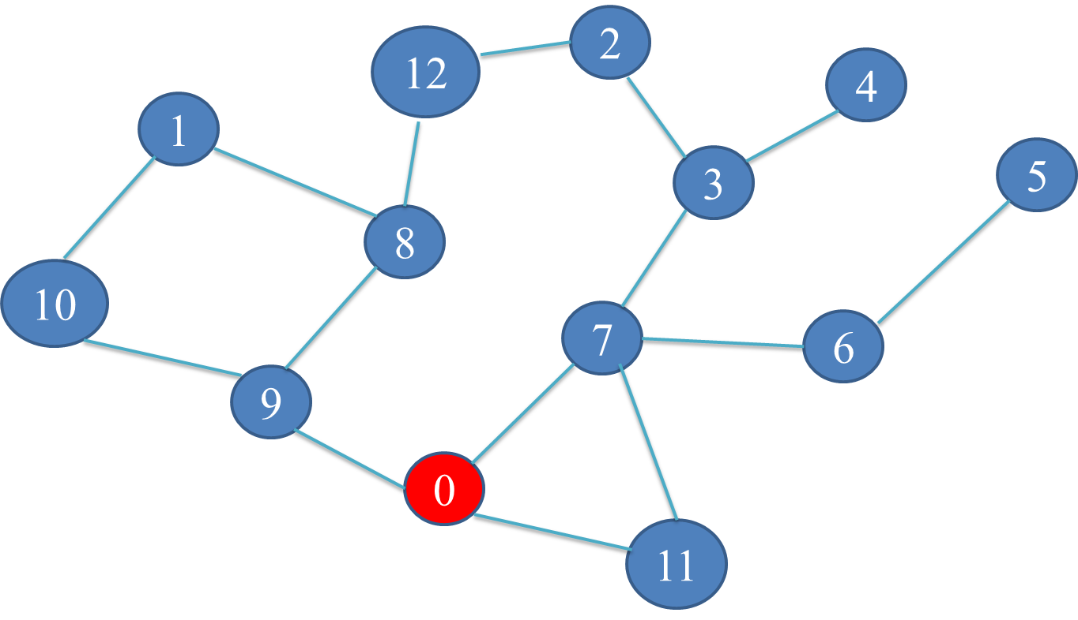
Machine Learning

Slide 57
Depth-first Search:
It is a recursive algorithm to search all the vertices of a tree data structure or a graph.
The depth-first search (DFS) algorithm starts with the initial node of graph G and goes deeper until we find the goal node or the node with no children.
Stack data structure can be used to implement the DFS algorithm because of its recursive nature.
A standard DFS implementation puts each vertex of the graph into one of two categories:
(i) Visited (ii) Not Visited
Machine Learning

Slide 58
Advantages:
Requires less memory.
It can find solution with examining much search space.
Takes less time to reach goal node than BFS algorithm.
Disadvantages:
Time complexity is more
Can get trapped in infinite loop.
Machine Learning

Slide 59
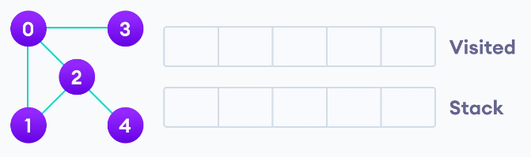
Steps Involved in DFS
Step 1. Start by putting any one of the graph's vertices on top of a stack.
Step 2. Take the top item of the stack and add it to the visited list.
Step 3. Create a list of that vertex's adjacent nodes. Add the ones which aren't in the visited list to the top of the stack.
Step 4. Keep repeating steps 2 and 3 until the stack is empty.
Example 1.
Answer::0, 1 , 2, 4, 3
Machine Learning

Slide 60
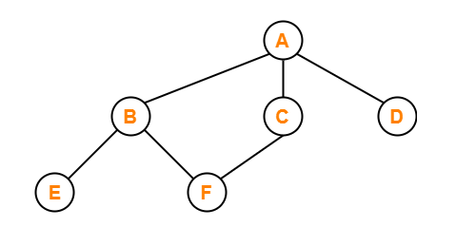
Example 2.
Answer:: A, B, E, F, C, D
Machine Learning

Slide 61
Difference between BFS and DFS
Parameter | BFS | DFS
Approach used | It works on the concept of FIFO (First In First Out). | It works on the concept of LIFO (Last In First Out).
Suitable for | Searching vertices closer to the given source. | When there are solutions away from source.
Memory | Requires more memory. | Requires less memory.
Speed | Slow | Fast
Data Structure | Uses Queue data structure for finding the shortest path. | Uses Stack data structure.
Machine Learning

Slide 62
Uniform-cost Search Algorithm:
Uniform-cost search is a searching algorithm used for traversing a weighted tree or graph.
This algorithm comes into play when a different cost is available for each edge.
The primary goal of the uniform-cost search is to find a path to the goal node which has the lowest cumulative cost.
Uniform-cost search expands nodes according to their path costs from the root node.
It is implemented by the priority queue.
Uniform cost search is equivalent to BFS algorithm if the path cost of all edges is the same.
Machine Learning

Slide 63
Advantages:
Uniform cost search is optimal because at every state the path with the least cost is chosen.
Disadvantages:
It does not care about the number of steps involve in searching and only concerned about path cost. Due to which this algorithm may be stuck in an infinite loop.
Machine Learning

Slide 64
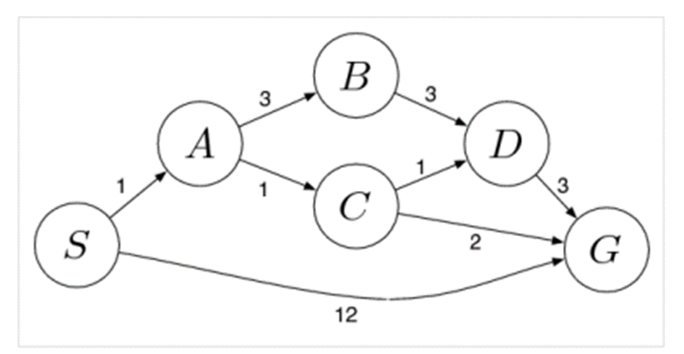
How Uniform Cost Search Works?
Insert the root into the queue While the queue is not empty Dequeue the maximum priority element from the queue (If priorities are same, alphabetically smaller path is chosen) If the path is ending in the goal state, print the path and exit Else Insert all the children of the dequeued element, with the cumulative costs as priority
Machine Learning

Slide 65
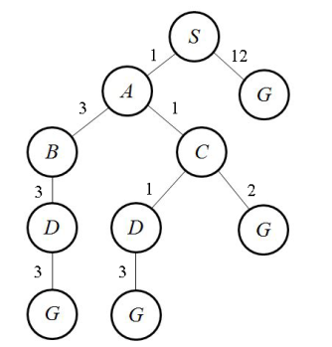
Initialization: { [ S , 0 ] }
Iteration 1: { [ S->A , 1 ] , [ S->G , 12 ] }
Iteration 2: { [ S->A->C , 2 ] , [ S->A->B , 4 ] , [ S->G , 12] }
Iteration 3: { [ S->A->C->D , 3 ] , [ S->A->B , 4 ] , [ S->A->C->G , 4 ] , [ S->G , 12 ] }
Iteration 4: { [ S->A->B , 4 ] , [ S->A->C->G , 4 ] , [ S->A->C->D->G , 6 ] , [ S->G , 12 ] }
Iteration 5: { [ S->A->C->G , 4 ] , [ S->A->C->D->G , 6 ] , [ S->A->B->D , 7 ] , [ S->G , 12 ] }
Iteration 6 gives the final output as S->A->C->G.
Machine Learning

Slide 66
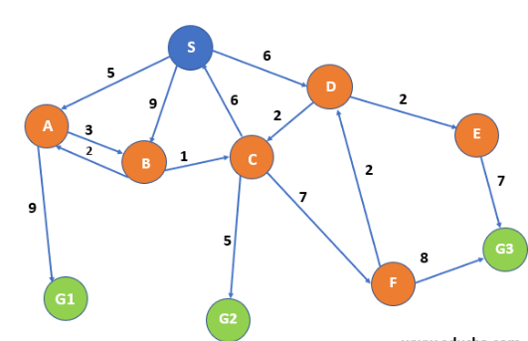
Machine Learning

Slide 67
Depth-Limited Search Algorithm:
A depth-limited search algorithm is similar to depth-first search with a predetermined limit.
Depth-limited search can solve the drawback of the infinite path in the Depth-first search. .
In this algorithm, the node at the depth limit will treat as it has no successor nodes further.
Depth-limited search can be terminated with two Conditions of failure:
(i) Standard failure value: It indicates that problem does not have any solution.
(ii) Cutoff failure value: It defines no solution for the problem within a given depth limit.
Machine Learning

Slide 68
Advantages:
Depth-limited search is Memory efficient.
Disadvantages:
Depth-limited search also has a disadvantage of incompleteness.
It may not be optimal if the problem has more than one solution.
Machine Learning

Slide 69
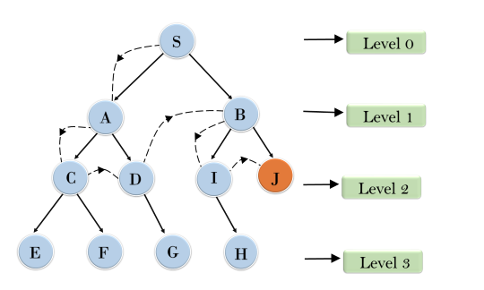
Machine Learning

Slide 70
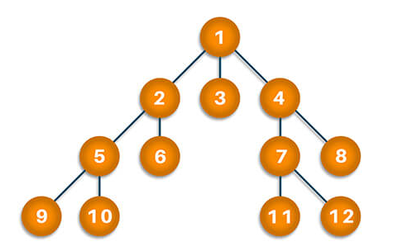
Machine Learning

Slide 71
Iterative Deepening Depth-First Search (IDDFS)
The Iterative Deepening Depth-First Search (or Iterative Deepening search) algorithm, repeatedly applies depth-limited search with increasing limits.
It gradually increases limits from 0,1,...d, until the goal node is found.
It terminates in the following two cases:
(1) When the goal node is found
(2) The goal node does not exist in the graph/tree.
Machine Learning

Slide 72
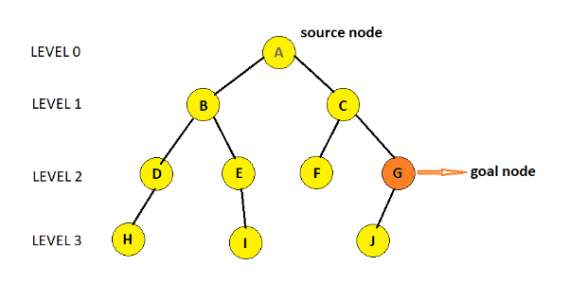

Machine Learning

Slide 73
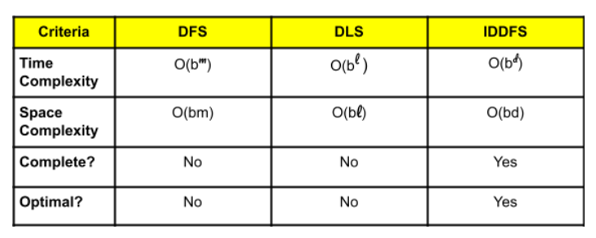
Time Complexity of IDDFS
Branching factor (b): The average number of children of each node.
If b is the branching factor, and d is the depth of the goal node or the depth at which the iteration of IDDFS function terminates, the time complexity is O(b^d) and space complexity is O(bd).
Comparison between DFS, DLS and IDDFS
Machine Learning

Slide 74
Bidirectional Search:
Bidirectional Search is Graph Search Algorithm where two graph traversals take place at the same time and is used to find the shortest distance between a fixed start vertex and end vertex.
It is a faster approach, reduces the time required for traversing the graph.
It significantly reduces the amount of exploration done.
It is implemented using the Breadth First Search (BFS) Algorithm.
The search is terminated when the two trees intersect.
It runs two simultaneous search –
(1) Forward search from source vertex toward goal vertex.
(2) Backward search from goal vertex toward source vertex
Machine Learning

Slide 75
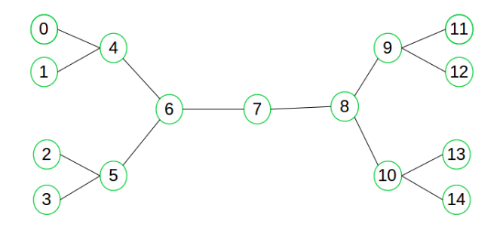
Intersection node
Machine Learning

Slide 76
Informed Search Algorithms:
Informed search algorithm contains an array of knowledge, such as :
(1) How far we are from the goal
(2) Path cost
(3) How to reach to goal node
This knowledge help agents to explore less to the search space and find more efficiently the goal node.
The informed search algorithm is more useful for large search space.
Informed search algorithm uses the idea of heuristic, so it is also called Heuristic search.
Machine Learning

Slide 77
Heuristics function: Heuristic is a function which is used in Informed Search, and it finds the most promising path.
It takes the current state of the agent as its input and produces the estimation of how close agent is from the goal.
The heuristic method, however, might not always give the best solution, but it guaranteed to find a good solution in reasonable time.
It is represented by h(n), and it calculates the cost of an optimal path between the pair of states.
The value of the heuristic function is always positive.
Machine Learning

Slide 78
Greedy-best-first Search:
Greedy Best-First Search is an AI search algorithm that attempts to find the most promising path from a given starting point to a goal.
It prioritizes paths that appear to be the most promising, regardless of whether or not they are actually the shortest path.
The algorithm works by evaluating the cost of each possible path and then exploring the path with the lowest cost.
This process is repeated until the goal is reached.
Machine Learning

Slide 79
How Greedy Best-First Search Works?
Greedy Best-First Search works by evaluating the cost of each possible path and then exploring the path with the lowest cost. This process is repeated until the goal is reached.
The algorithm uses a heuristic function to determine which path is the most promising.
The heuristic function takes into account the cost of the current path and the estimated cost of the remaining paths.
If the cost of the current path is lower than the estimated cost of the remaining paths, then the current path is chosen. This process is repeated until the goal is reached.
Machine Learning

Slide 80
Advantages:
Simple and Easy to Implement.
Fast and Efficient
Low Memory Requirements
Flexible
Disadvantages:
Inaccurate Results.
Local Optima
Heuristic Function
Machine Learning

Slide 81
Applications:
Pathfinding e.g. robotics, and navigation systems.
Machine Learning e.g. to find the most promising path through a search space.
Optimization e.g. to achieve the desired result.
Machine Learning

Slide 82
Difference between Greedy-firsts search algorithm and uniform cost search algorithm
Greedy Search doesn't go back up the tree - it picks the lowest value and commits to that. Uniform-Cost will pick the lowest total cost from the entire tree.
Greedy Search is an informed search algorithm while uniform cost search is uninformed search algorithm.
Machine Learning

Slide 83
A* Search Algorithm
It is an informed search algorithm that estimates the remaining distance to the goal, to guide the search.
A* search algorithm is one of the best and popular technique used in path-finding and graph traversals.
The A* search algorithm is widely used in robotics, video games, and other fields where finding the shortest path between two points is critical.
It works by expanding the node with the lowest cost, which is determined by the sum of the cost from the start node to the current node.
Machine Learning

Slide 84
Working
At each step it picks the node according to a value-‘f’.
‘f’ is a parameter equal to the sum of two other parameters – ‘g’ and ‘h’.
At each step it picks the node/cell having the lowest ‘f’, and process that node/cell.
f (n) = g(n) + h(n)
n = previous node on the path.
g(n) = cost of the path from the start node to ‘n’.
h(n) = is a heuristic , estimates the cost of the cheapest path from ‘n’ to the target node.
Machine Learning

Slide 85
Minmax Algorithm
Mini-max algorithm is a recursive or backtracking algorithm which is used in decision-making and game theory.
Mini-Max algorithm uses recursion to search through the game-tree.
In this algorithm two players play the game, one is called MAX and other is called MIN.
Both Players of the game are opponent of each other, where MAX will select the maximized value and MIN will select the minimized value.
Machine Learning

Slide 86
At the terminal node, the terminal values are given so we will compare those value and backtrack the tree until the initial state occurs.
Properties:
Min-Max algorithm is Complete. It will definitely find a solution (if exist), in the finite search tree.
Min-Max algorithm is optimal if both opponents are playing optimally.
The time complexity of Min-Max algorithm is O(b^{m}), where b is branching factor of the game-tree and ‘m’ is the maximum depth of the tree.
Machine Learning

Slide 87
Applications:
Min-Max algorithm is mostly used for game playing in AI. Such as Chess, Checkers, tic-tac-toe, go, and various tow-players game.
Limitations:
Because of the huge branching factor, the process of reaching the goal is slower. For complex games such as Chess etc.
Machine Learning

Slide 88
Alpha-Beta Pruning
Alpha-beta pruning is a modified version of the minimax algorithm. It is an optimization technique for the minimax algorithm.
Without checking each node of the game tree it can compute the correct minimax decision.
This involves two threshold parameter Alpha and beta for future expansion, so it is called alpha-beta pruning algorithm.
The two-parameter can be defined as:
Alpha: The best (highest-value) choice we have found so far at any point along the path of Maximizer. The initial value of alpha is -∞.
Beta: The best (lowest-value) choice we have found so far at any point along the path of Minimizer. The initial value of beta is +∞.
Machine Learning

Slide 89
It removes all the nodes which are not really affecting the final decision but making algorithm slow.
The main condition which required for alpha-beta pruning is:
α>=β
Points should be kept in mind
The Max player will only update the value of alpha.
The Min player will only update the value of beta.
While backtracking the tree, the node values will be passed to upper nodes instead of values of alpha and beta.
We will only pass the alpha, beta values to the child nodes.
Machine Learning

Slide 90
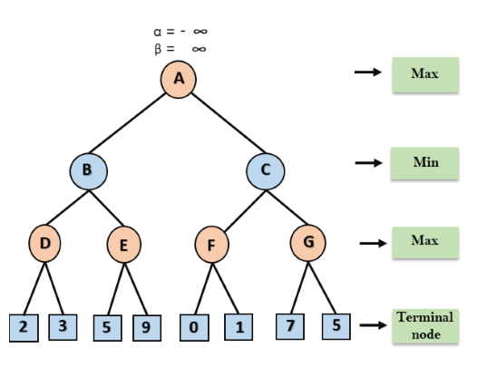
Machine Learning

Slide 91
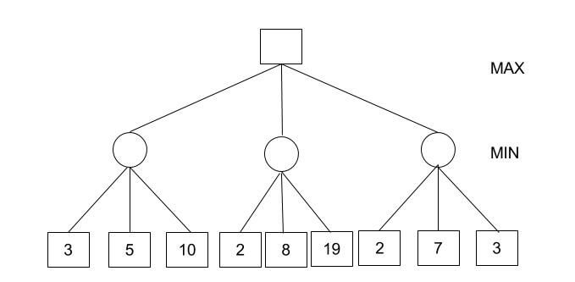
Machine Learning

Slide 92
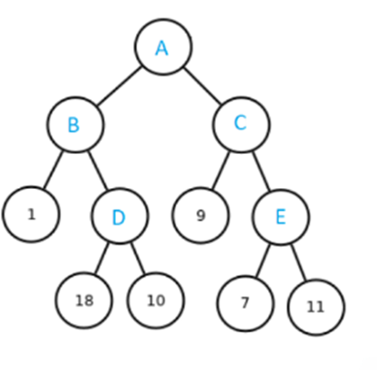
Machine Learning

Slide 93
Knowledge based agent
An intelligent agent needs knowledge about the real world for taking decisions and reasoning to act efficiently.
They are having the capability of:
maintaining an internal state of knowledge
reason over that knowledge
update their knowledge after observations and take actions
Knowledge-based agents are composed of two main parts:
Knowledge-base
Inference system.
Machine Learning

Slide 94
A knowledge-based agent must able to do the following:
An agent should be able to represent states, actions, etc.
An agent Should be able to incorporate new percepts
An agent can update the internal representation of the world
An agent can deduce the internal representation of the world
An agent can deduce appropriate actions.
Machine Learning

Slide 95
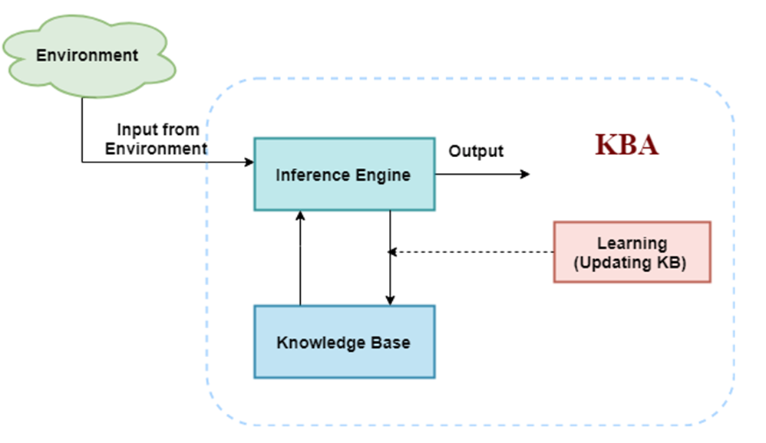
Architecture of knowledge based agent system
Machine Learning

Slide 96
Different levels of knowledge-based agent
Knowledge level
We need to specify what the agent knows, and what the agent goals are.
With these specifications, we can fix its behavior.
Example: Suppose an automated taxi agent needs to go from a station A to station B, and he knows the way from A to B.
Logical level
It signifies how the knowledge representation of knowledge is stored.
At this level, sentences are encoded into different logics.
Machine Learning

Slide 97
At the logical level we can expect to the automated taxi agent to reach to the destination B.
3. Implementation level
It is the physical representation of logic and knowledge.
At this level agent perform actions as per logical and knowledge level.
At this level, an automated taxi agent actually implement his knowledge and logic so that he can reach to the destination.
Machine Learning

Slide 98
Propositional logic
Propositional logic (PL) is the simplest form of logic where all the statements are made by propositions.
A proposition is a declarative statement which is either true or false.
It is a technique of knowledge representation in logical and mathematical form.
Example:
a) It is Sunday.
b) The Sun rises from West (False proposition)
c) 3+3= 7(False proposition)
d) 5 is a prime number.
Machine Learning

Slide 99
Key points
Propositional logic is also called Boolean logic as it works on 0 and 1.
Propositions can be either true or false, but it cannot be both.
Propositional logic consists of an object, relations or function, and logical connectives.
Connectives can be said as a logical operator which connects two sentences.
A proposition formula which is always true is called a valid sentence.
A proposition formula which is always false is called Contradiction.
A proposition formula which has both true and false values is called contingency.
Machine Learning

Slide 100
Wumpus World
Wumpus world is a simple world example to illustrate the worth of a knowledge-based agent and to represent knowledge representation.
Inspired by a video game Hunt the Wumpus by Gregory Yob in 1973.
Description of Model
Wumpus world is a cave which has 4/4 rooms connected with passageways. So there are total 16 rooms which are connected with each other.
We have a knowledge-based agent who will go forward in this world.
Machine Learning

Slide 101
(3) The cave has a room with a beast which is called Wumpus, who eats anyone who enters the room.
(4) The Wumpus can be shot by the agent, but the agent has a single arrow.
(5) In the Wumpus world, there are some Pits rooms which are bottomless, and if agent falls in Pits, then he will be stuck there forever.
(6) the exciting thing with this cave is that in one room there is a possibility of finding a heap of gold. So the agent goal is to find the gold and climb out the cave without fallen into Pits or eaten by Wumpus.
(7) The agent will get a reward if he comes out with gold, and he will get a penalty if eaten by Wumpus or falls in the pit.
Machine Learning

Slide 102
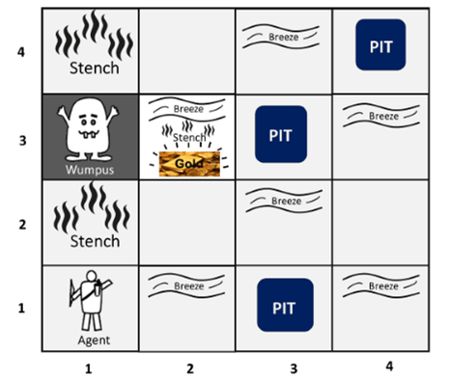
Representation of Wumpus world algorithm
Machine Learning

Slide 103
Assumptions
The rooms adjacent to the Wumpus room are smelly, so that it would have some stench.
The room adjacent to PITs has a breeze, so if the agent reaches near to PIT, then he will perceive the breeze.
There will be glitter in the room if and only if the room has gold.
The Wumpus can be killed by the agent if the agent is facing to it, and Wumpus will emit a horrible scream which can be heard anywhere in the cave.
Machine Learning

Slide 104
Wumpus world Properties:
Partially observable: The Wumpus world is partially observable because the agent can only perceive the close environment such as an adjacent room.
Deterministic: It is deterministic, as the result and outcome of the world are already known.
Sequential: The order is important, so it is sequential.
Static: It is static as Wumpus and Pits are not moving.
Discrete: The environment is discrete.
One agent: The environment is a single agent as we have one agent only and Wumpus is not considered as an agent.
Machine Learning

Slide 105
Forward chaining vs. Backward chaining
Forward Chaining | Backward Chaining
Forward chaining starts from known facts and applies inference rule to extract more data unit it reaches to the goal. | Backward chaining starts from the goal and works backward through inference rules to find the required facts that support the goal.
It is a bottom-up approach | It is a top-down approach
Forward chaining reasoning applies a breadth-first search strategy. | Backward chaining reasoning applies a depth-first search strategy.
Forward chaining can generate an infinite number of possible conclusions. | Backward chaining generates a finite number of possible conclusions.
It operates in the forward direction. | It operates in the backward direction.
Forward chaining is aimed for any conclusion. | Backward chaining is only aimed for the required data.
Forward chaining tests for all the available rules | Backward chaining only tests for few required rules.
Forward chaining is suitable for the planning, monitoring, control, and interpretation application. | Backward chaining is suitable for diagnostic, prescription, and debugging application.
Machine Learning

Slide 106
First-Order logic (FOL):
First-order logic is another way of knowledge representation in artificial intelligence. It is an extension to propositional logic.
FOL is sufficiently expressive to represent the natural language statements in a concise way.
First-order logic is also known as Predicate logic or First-order predicate logic. First-order logic is a powerful language that develops information about the objects in a more easy way and can also express the relationship between those objects.
First-order logic (like natural language) does not only assume that the world contains facts like propositional logic but also assumes the following things in the world:
Machine Learning

Slide 107
Objects: A, B, people, numbers, colors, wars, theories, squares, pits, Wumpus, ......
Relations: It can be unary relation such as: red, round, is adjacent, or n-any relation such as: the sister of, brother of, has color, comes between
Function: Father of, best friend, third inning of, end of, ......
Quantifiers in First-order logic
A quantifier is a language element which generates quantification, and quantification specifies the quantity of specimen in the universe of discourse.
These are the symbols that permit to determine or identify the range and scope of the variable in the logical expression. There are two types of quantifier:
(i) Universal Quantifier, (for all, everyone, everything)
(ii) Existential quantifier, (for some, at least one).
Machine Learning

Slide 108
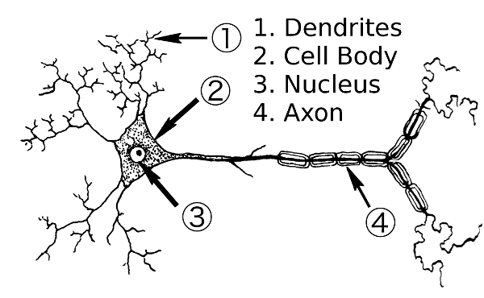
Structure of Neuron:
Machine Learning

Slide 109
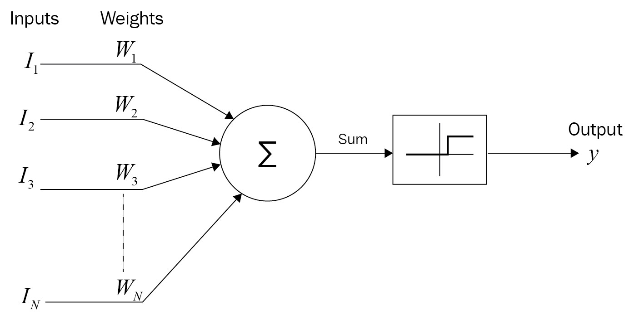
McCulloch-Pitts Neuron
An Activation Function decides whether a neuron should be activated or not. This means that it will decide whether the neuron’s input to the network is important or not in the process of prediction using simpler mathematical operations.
Machine Learning

Slide 110
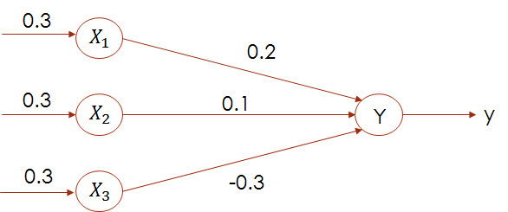
Q1. For the network shown in Figure, calculate the net input to the output neuron.
Solution: The given neural net consists of three input neurons and one output neuron. The inputs and weights are
[𝑥₁, 𝑥₂, 𝑥₃] = [0.3,0.5,0.6]
𝑤₁, 𝑤₂, 𝑤₃ = [0.2,0.1, −0.3]
The net input can be calculated as
𝑦_{𝑖𝑛} = 𝑥₁𝑤₁ + 𝑥₂𝑤₂ + 𝑥₃𝑤₃
= 0.3 × 0.2 + 0.5 × 0.1 + 0.6 × −0.3
= 0.06 + 0.05 − 0.18 = −0.07
Machine Learning

Slide 111
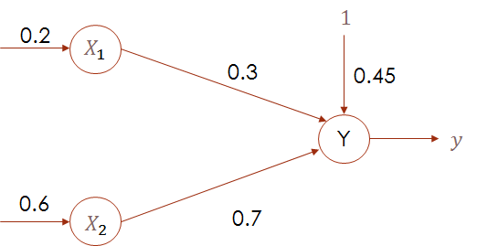
Q2. Calculate the net input for the network shown in Figure with bias included in the network.
Answer- 0.93
Machine Learning

Slide 112
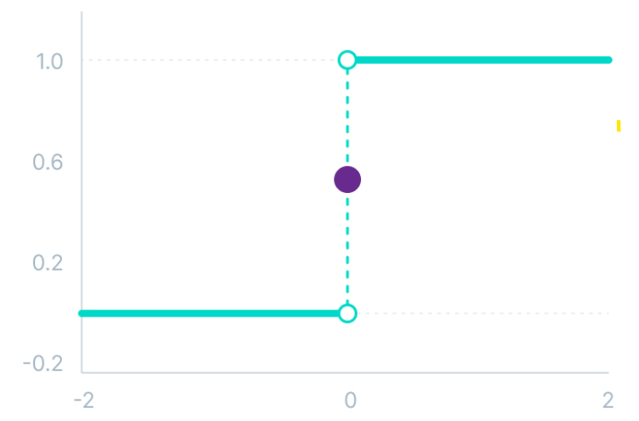
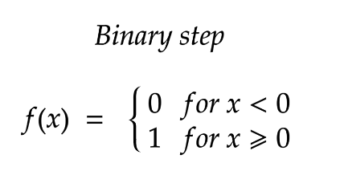
Binary Step Function
Binary step function depends on a threshold value that decides whether a neuron should be activated or not.
The input fed to the activation function is compared to a certain threshold; if the input is greater than it, then the neuron is activated, else it is deactivated, meaning that its output is not passed on to the next hidden layer
Machine Learning

Slide 113
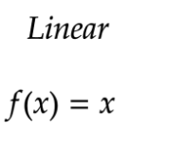
Linear Activation Function
The linear activation function, also known as "no activation," or "identity function" (multiplied x1.0), is where the activation is proportional to the input.
The function doesn't do anything to the weighted sum of the input, it simply spits out the value it was given.
Machine Learning

Slide 114
However, a linear activation function has two major problems :
It’s not possible to use backpropagation as the derivative of the function is a constant and has no relation to the input x.
All layers of the neural network will collapse into one if a linear activation function is used.
Machine Learning

Slide 115
Non-Linear Activation Functions
Non-linear activation functions solve the following limitations of linear activation functions:
They allow backpropagation because now the derivative function would be related to the input, and it’s possible to go back and understand which weights in the input neurons can provide a better prediction.
They allow the stacking of multiple layers of neurons as the output would now be a non-linear combination of input passed through multiple layers.
Machine Learning

Slide 116
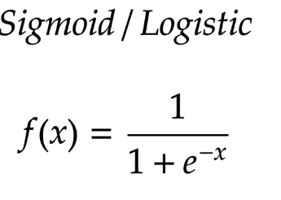
Non-Linear Neural Networks Activation Functions
Sigmoid / Logistic Activation Function
This function takes any real value as input and outputs values in the range of 0 to 1.
The larger the input (more positive), the closer the output value will be to 1.0.
Machine Learning

Slide 117
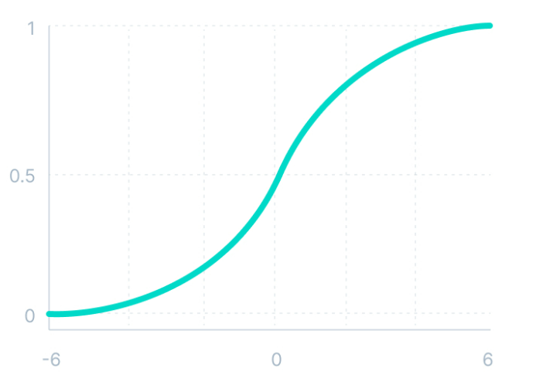
Why sigmoid/logistic activation function is one of the most widely used functions:
It is commonly used for models where we have to predict the probability as an output.
The function is differentiable and provides a smooth gradient, i.e., preventing jumps in output values.
Machine Learning
Notes:
Since probability of anything exists only between the range of 0 and 1, sigmoid is the right choice because of its range.

Slide 118
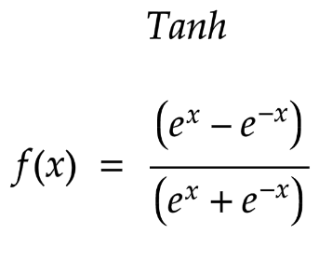
Tanh Function (Hyperbolic Tangent)
Tanh function is very similar to the sigmoid/logistic activation function, with the difference in output range of -1 to 1.
In Tanh, the larger the input (more positive), the closer the output value will be to 1.0, whereas the smaller the input (more negative), the closer the output will be to -1.0.
Machine Learning

Slide 119
Advantages of using this activation function are:
The output of the tanh activation function is Zero centered; hence we can easily map the output values as strongly negative, neutral, or strongly positive.
Usually used in hidden layers of a neural network as its values lie between -1 to; therefore, the mean for the hidden layer comes out to be 0 or very close to it.
It helps in centering the data and makes learning for the next layer much easier.
Machine Learning

Slide 120
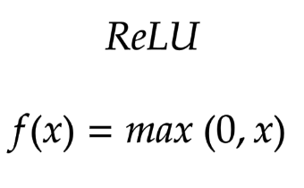
ReLU Function
ReLU stands for Rectified Linear Unit.
The ReLU function does not activate all the neurons at the same time.
The neurons will only be deactivated if the output of the linear transformation is less than 0.
Mathematically it can be represented as:
Advantages
Computationally efficient when compared to the sigmoid and tanh functions.
Machine Learning

Slide 121
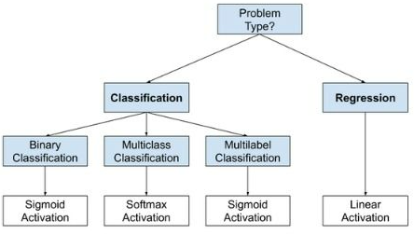
How to choose activation function ??
Machine Learning

Slide 122
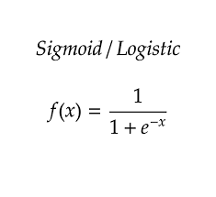

Q3. Obtain the output of the neuron Y for the network shown in Figure using activation function as: binary sigmoidal.
Solution: 𝑦_{𝑖𝑛}
[n=3, because only 3 input neurons are given]
= b + x₁ w₁ + x₂w₂ + x₃w₃
= 0.35 + 0.8 × 0.1 + 0.6 × 0.3 + 0.4 ×(−0.2)
= 0.35 + 0.08 + 0.18 − 0.08 = 0.53
(i)For binary sigmoidal activation function,
Machine Learning

Slide 123
Levenberg-Marquardt algorithm (LM)
Levenberg Marquardt is also known as a damped least-squares method.
This algorithm is designed to work with loss function specifically.
This algorithm does not compute the Hessian matrix. It works with the Jacobian matrix and the gradient vector.
In Levenberg Marquardt, the First step is to find the loss, the gradient, and the Hessian approximation, and then the dumpling parameter is adjusted.
Machine Learning

Slide 124

A loss function is a mathematical function that measures the difference between the predicted output and the actual output.
Machine Learning

Slide 125
X₂
4
3
2
1
X₁
1
2
3
4
Machine Learning

